Slide 1
DOUBLY LINKED LIST

Slide 2
Doubly Linked List:
Each node has three parts data, pre and next. Here, pre contains the address of previous node.
Last node contains NULL value in next part.
First node contains NULL value in pre part.
A head node has the address of the first node.
A last node has the address of the last node.
Head node
last node
100
300
pre
data
next
NULL
2
200
100
4
300
200
6
NULL
200
300
100

Slide 3
DOUBLY LINKED LIST
The structure of node is defined as:
struct node
{
int num;
struct node *pre,*next;
};
Here data part num contains integer value, pre pointer stores the address of previous node and next pointer stores the address of the next node.

Slide 4
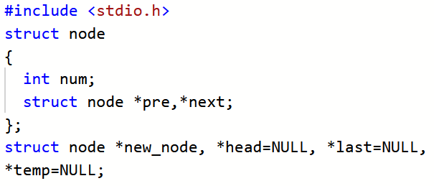
CREATION OF DOUBLY LINKED LIST

Slide 5
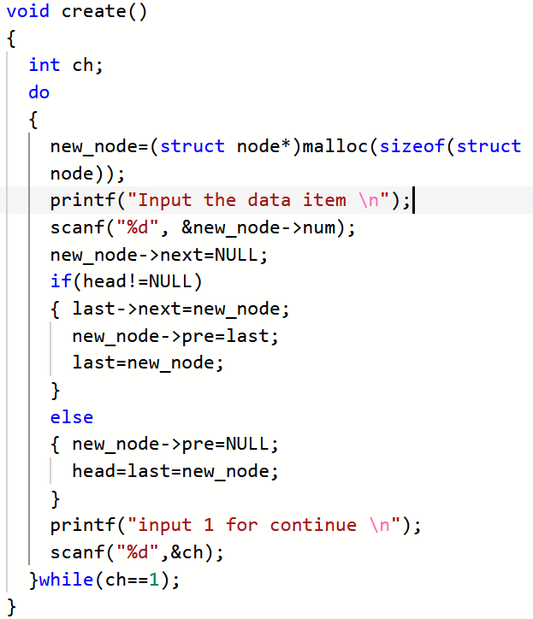

Slide 6
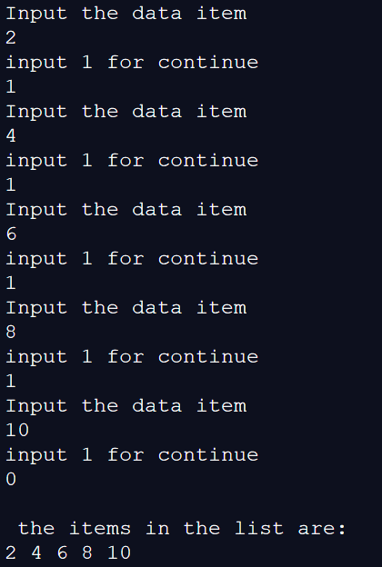
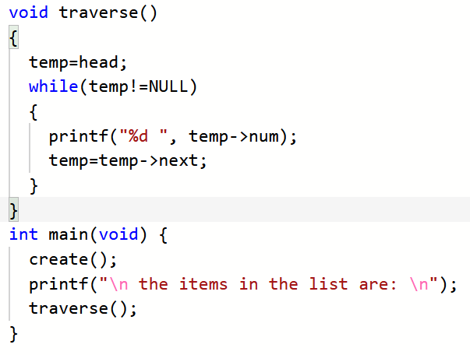

Slide 7
INSERTION AT THE BEGIN
Head Node
last Node
300
100
NULL
2
200
100
4
300
200
6
NULL
100
200
300
NULL
1
New Node
400
last Node
Head Node
400
300
NULL
1
100
400
2
200
100
4
300
200
6
NULL
400
100
200
300

Slide 8
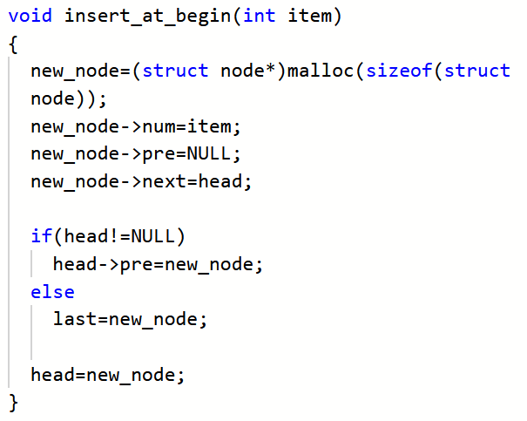

Slide 9
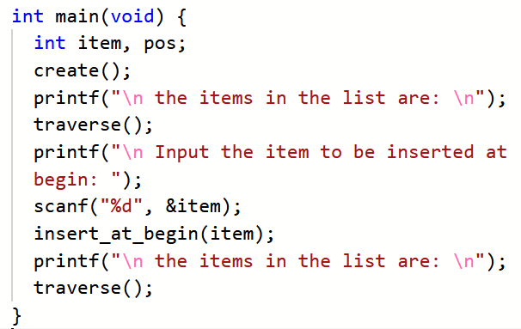
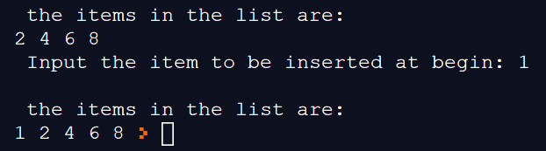

Slide 10
INSERTION AT THE END
Head Node
last Node
300
100
NULL
2
200
100
4
300
200
6
NULL
100
200
300
9
NULL
New Node
500
Head Node
400
500
NULL
2
200
100
4
300
200
6
500
300
7
NULL
100
200
300
500

Slide 11
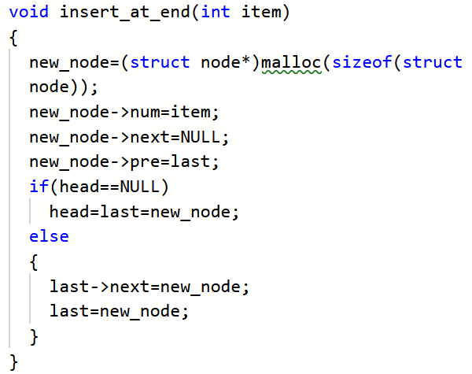

Slide 12
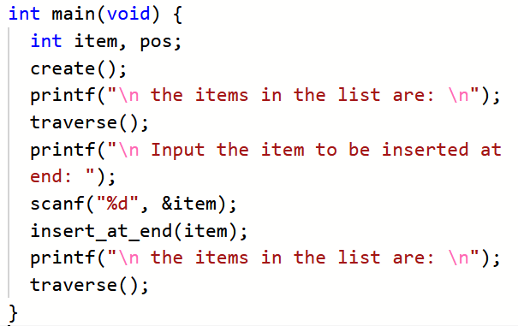
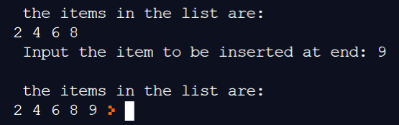

Slide 13
INSERTION AT SPECIFIED POSITION
Head Node
New Node
5
last Node
500
300
100
NULL
2
200
100
4
300
200
6
NULL
100
200
300
Head Node
last Node
400
300
NULL
2
200
100
4
500
200
5
300
500
6
NULL
100
200
500
300

Slide 14
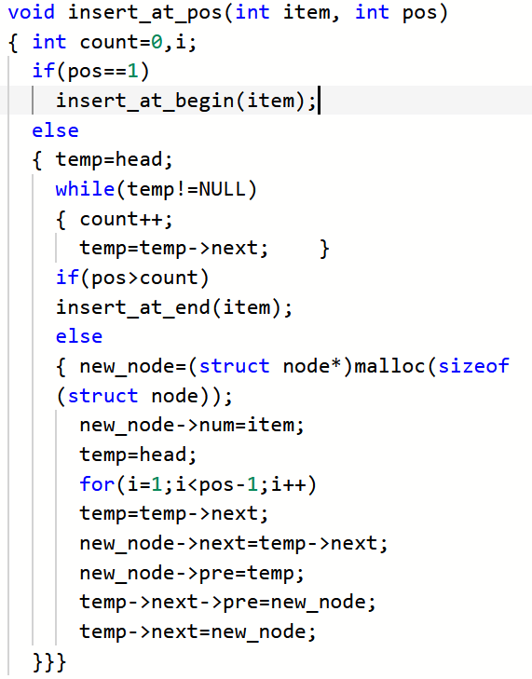

Slide 15
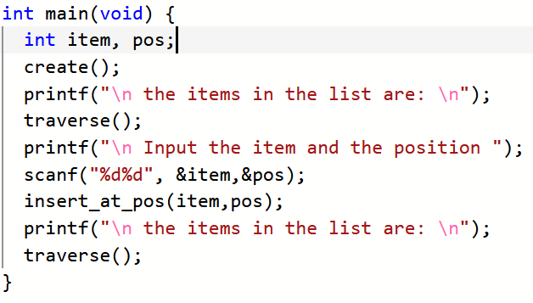
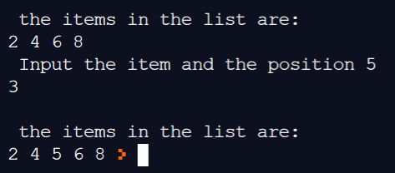

Slide 16
DELETE FROM BEGIN
last Node
Head Node
300
100
NULL
2
200
100
4
300
200
6
NULL
100
200
300
Head Node
last Node
200
300
NULL
4
300
200
6
NULL
200
300

Slide 17
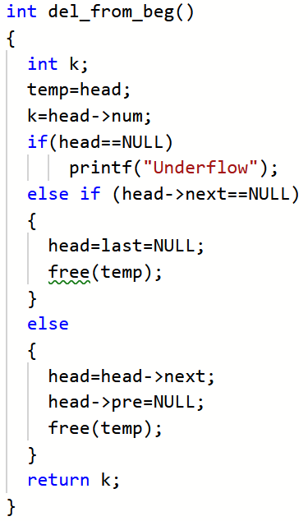

Slide 18
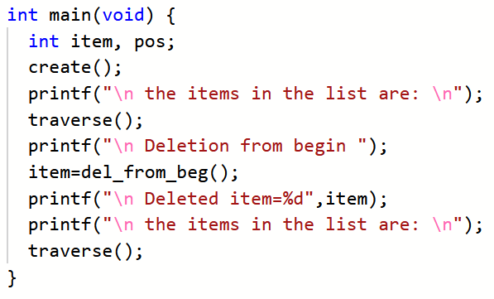
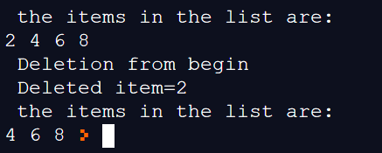

Slide 19
DELETE FROM END
last Node
Head Node
300
100
NULL
2
200
100
4
300
200
6
NULL
100
200
300
Head Node
last Node
100
200
NULL
2
200
100
4
NULL
100
200

Slide 20
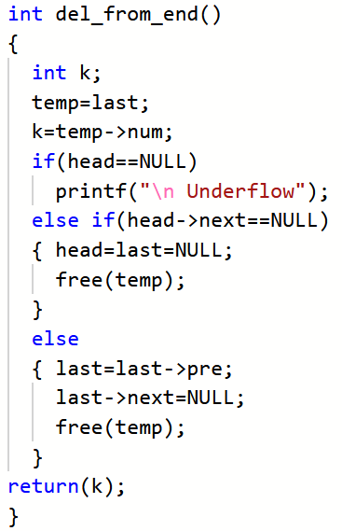

Slide 21
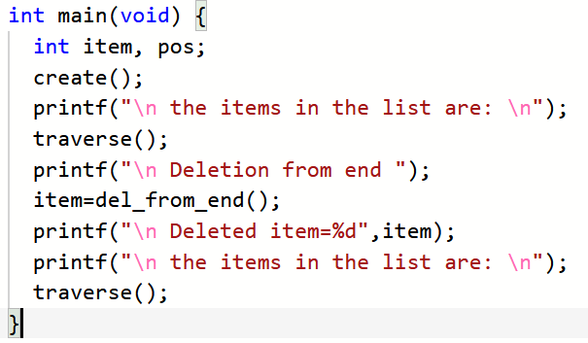
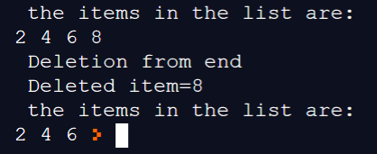

Slide 22
DELETE FROM SPECIFIC POSITION
last Node
Head Node
300
100
NULL
2
200
100
4
300
200
6
NULL
100
200
300
Head Node
last Node
100
300
NULL
2
300
100
4
NULL
100
300

Slide 23
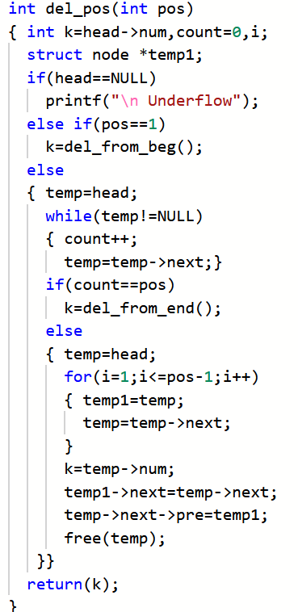

Slide 24
